Slide 1
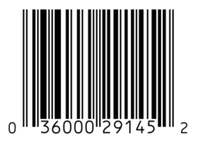
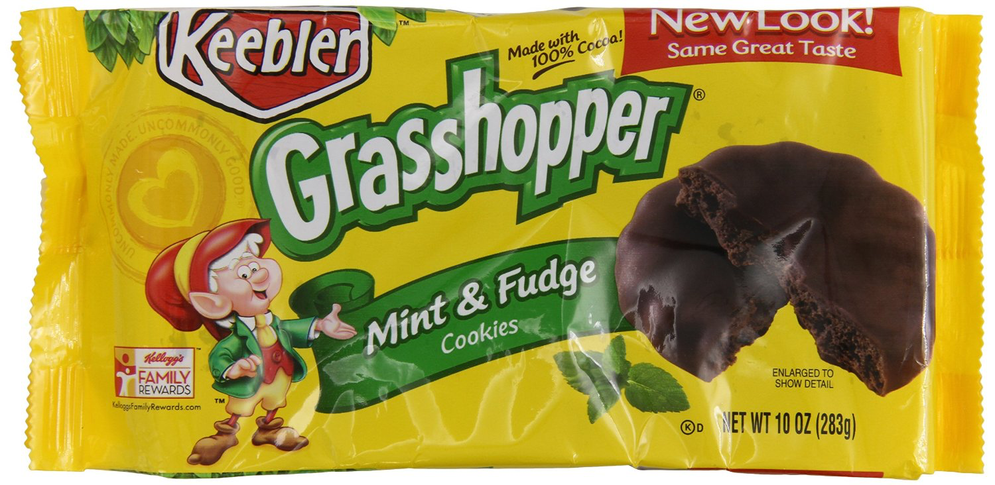
Source for UPC: http://www.cpsc.gov/Global/info/Recall/CPSC-Recalls-Retrieval-Web-Services-Programmers-Guide_3-25-2015.pdf
Issue with UPC:
CPSC does not have UPCs for every product recalled and companies use and re-use UPCs differently
A search by UPC can lead to false positive or false negative results
The RecallDescription or ProductName parameters include more complete and accurate recall information
Scan Barcode
Drill down on recall details
Include details such as recall severity, time frame, impacted region,
Keebler Fudge Grasshopper Cookies, Mint, 10 Ounce
Active Recall
Report location and product information (no personal information) to API
Enhance FDA data with crowdsourced, live feed of recalled products
Create API for “found recalled products”
Report to community

